Slide 1




Nanotechnology Student Branch Chapter of the National University of Science and Technology Politehnica, Bucharest, Romania
2nd Summit of IEEE EPS & NTC Student Branch Chapters
17th October 2023, Craiova, Romania

Slide 2
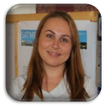
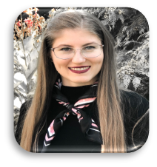
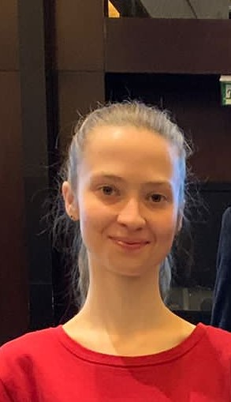
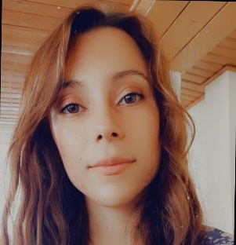
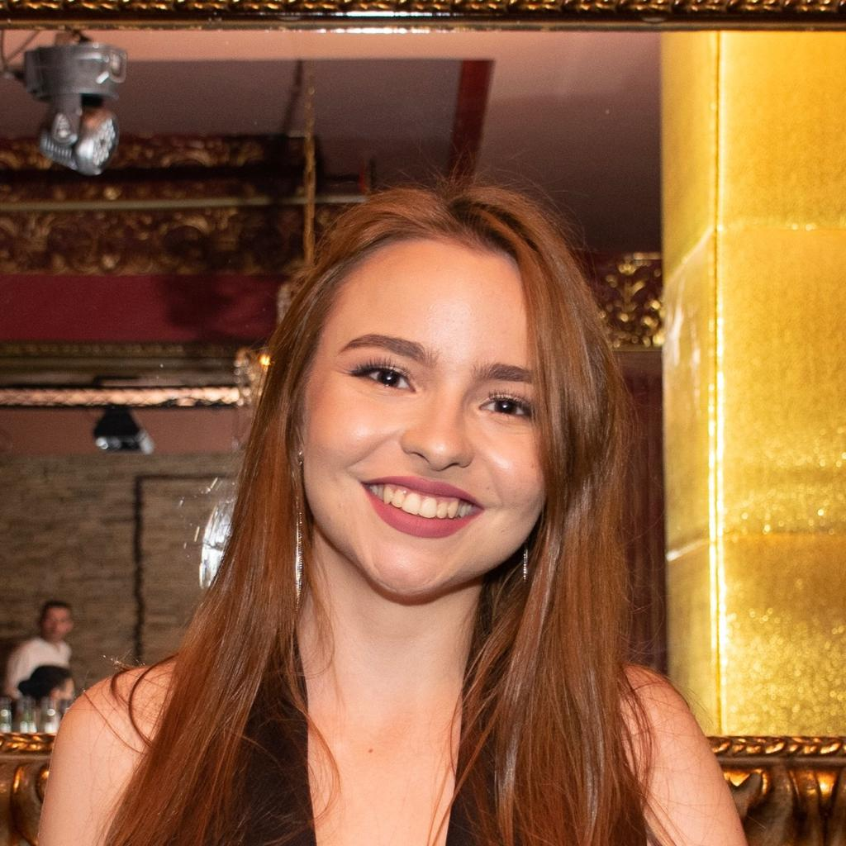
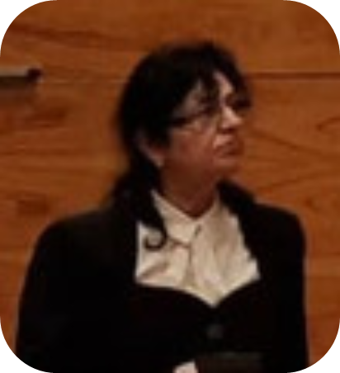
IEEE Nanotechnology Council Community 2023
Rodica-Cristina NEGROIU
~ Advisor ~
Mădălina-Irina BURCEA (IONECI)
~ Chair ~
Anda
JÂJÂIE
~ Vice-Chair ~
Andreea
CHIOREANU
~ Treasurer ~
Daria-Ioana
DEDU
~Secretary ~
Corina
SĂNDULESCU
~ Member ~

Slide 3
Our Recent Activities

Slide 4
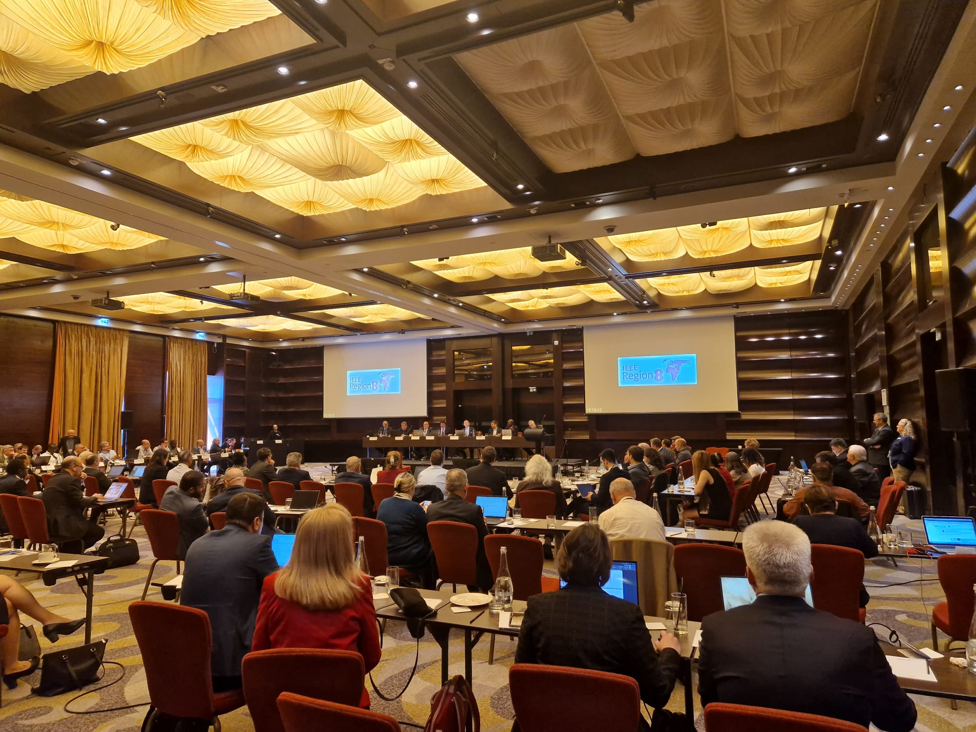
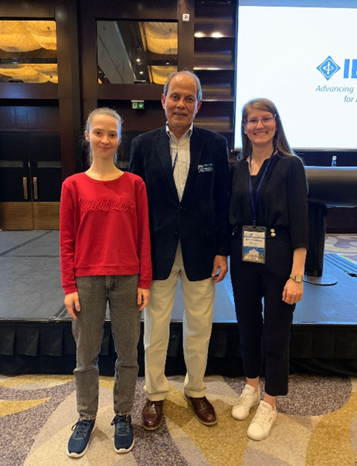
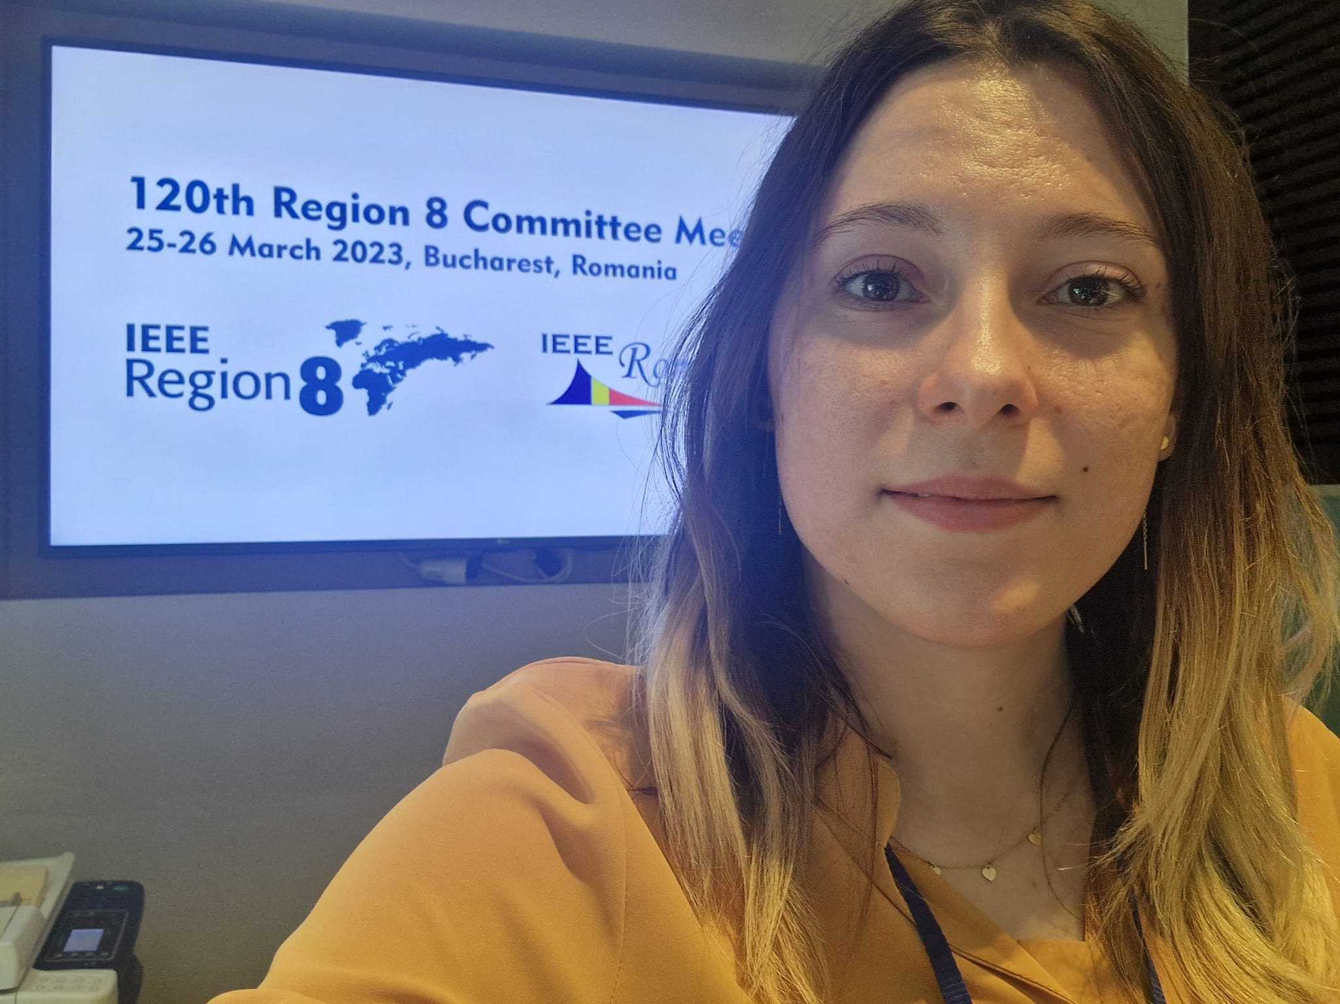
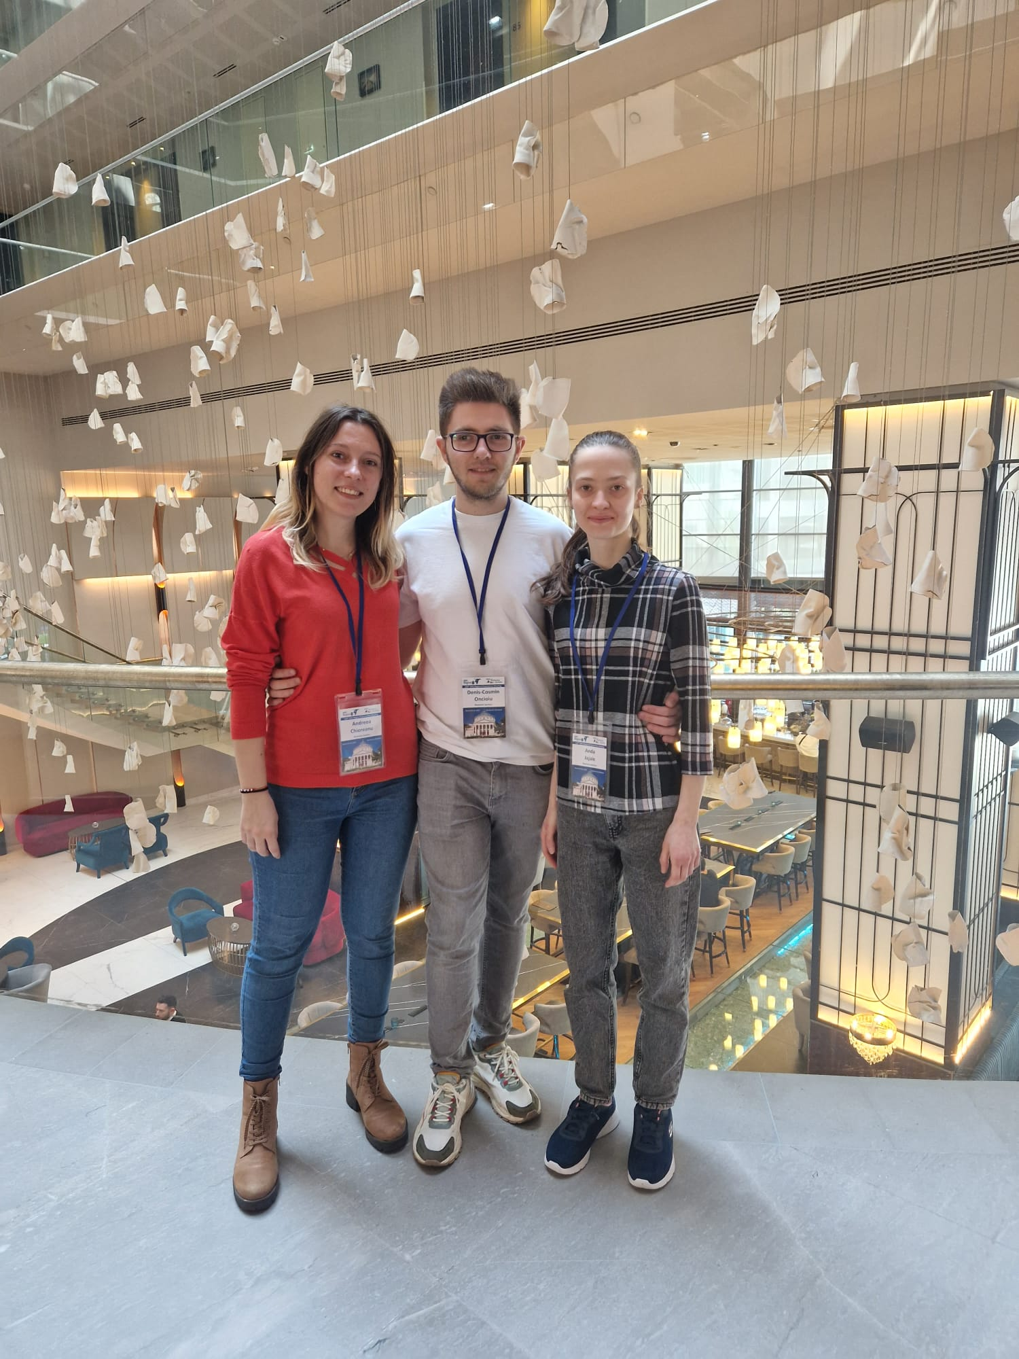
Organization of the 120th Region 8 Committee Meeting

Slide 5
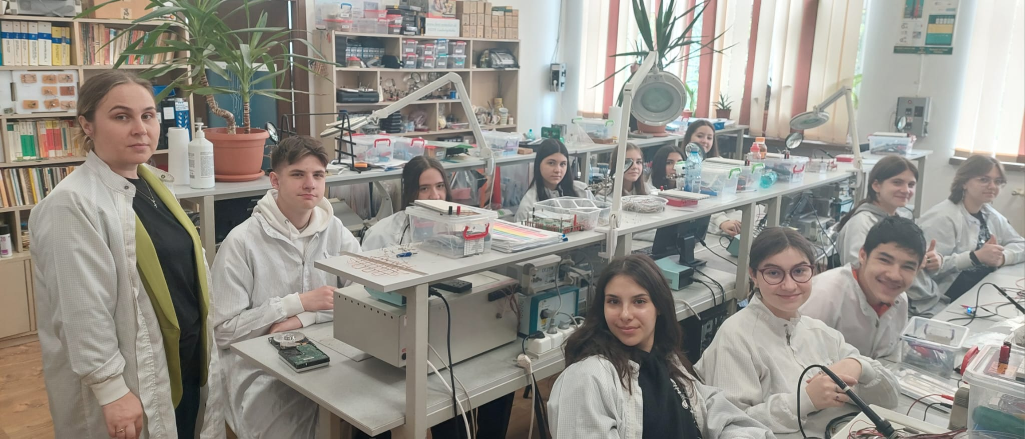
Our advisor coordinating the didactic activity with the students of the 8th grade

Slide 6
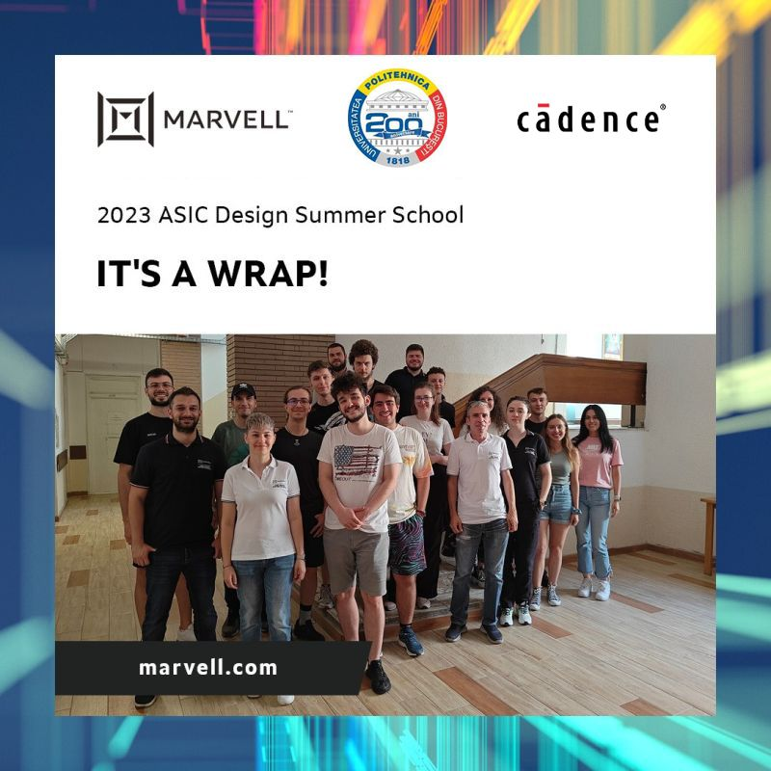
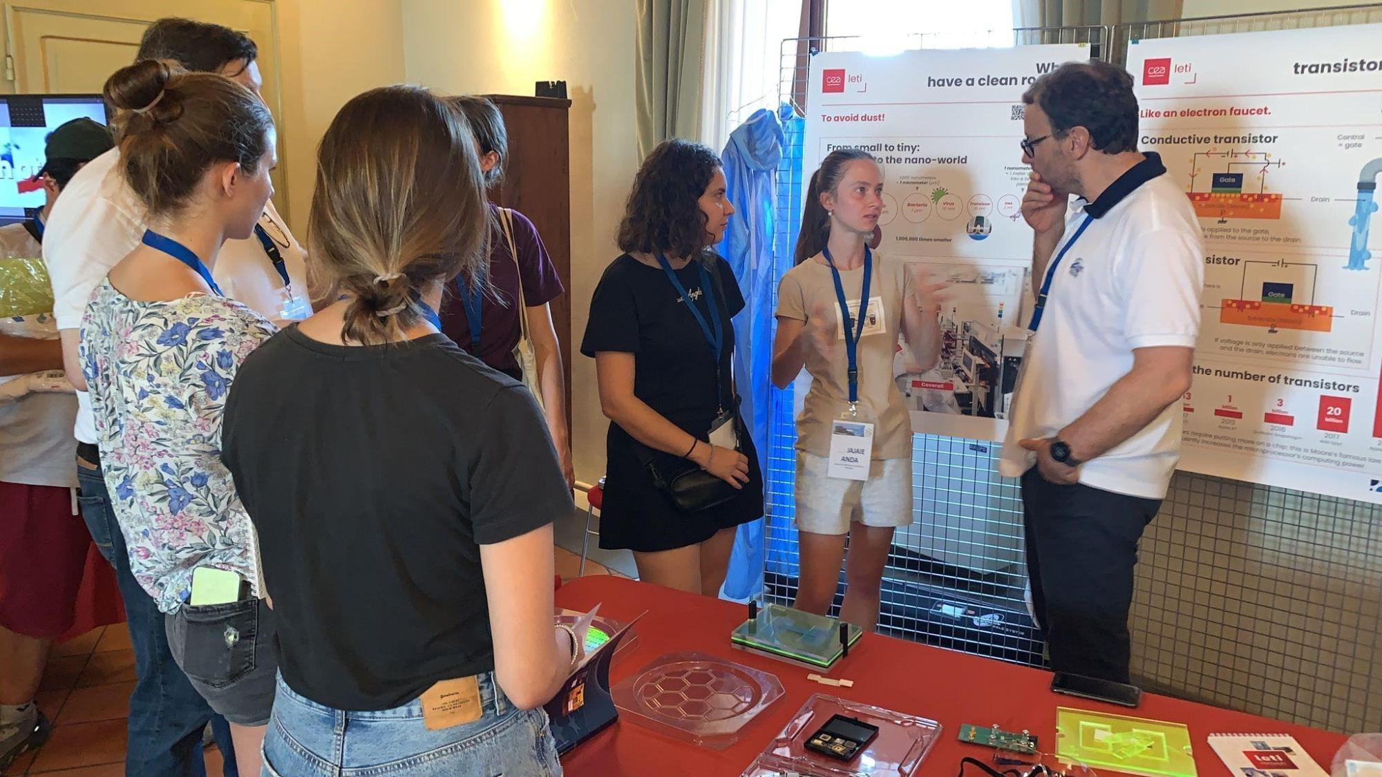
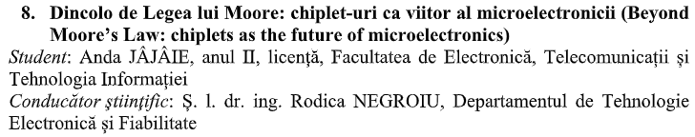
Our vice-chair activity
Participate to Student Scientific Communication Session
Fascinating Electronics for a Cool World Summer School 2023, Bertinoro, Italy, organized by EPoSS, Aeneas and Inside
ASIC Design Summer School 2023 organized by MARVELL

Slide 7
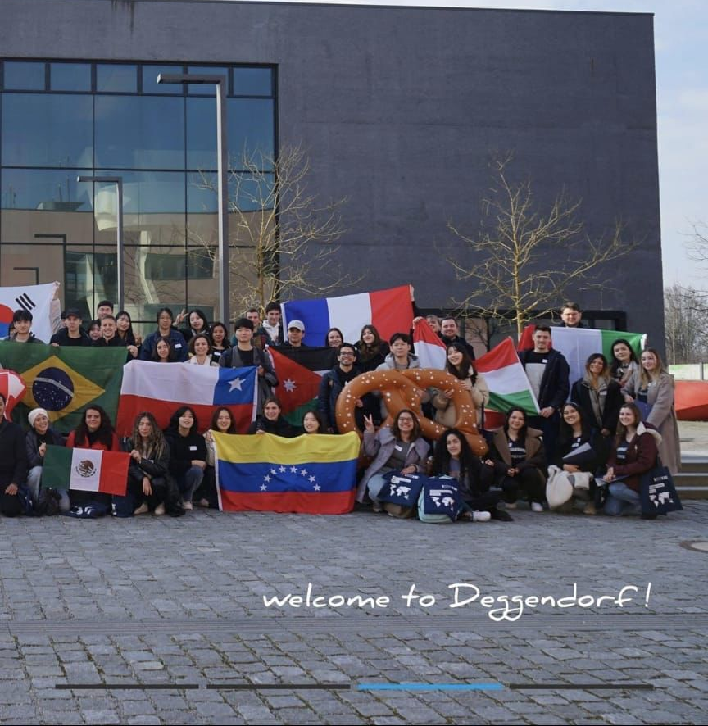
Our secretary study for a semester at the Deggendorf Institute of Technology in Germany through the Erasmus programme

Slide 8
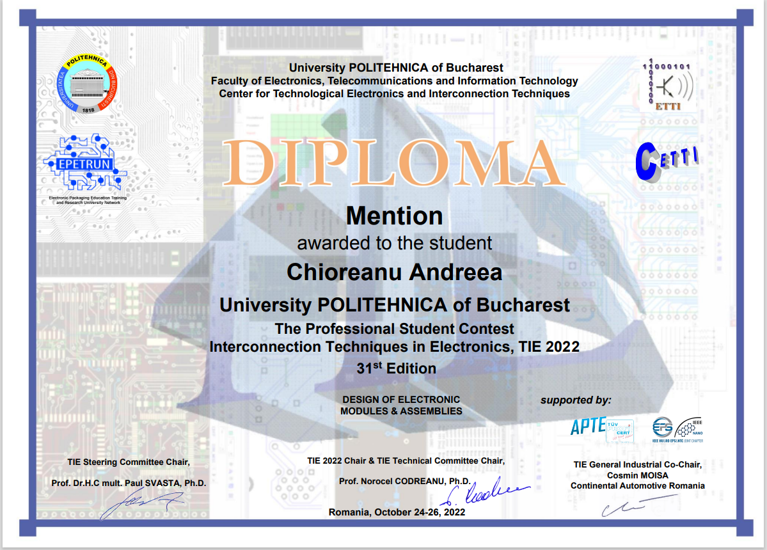
Our treasurer got a good score at the TIE contest
96

Slide 9
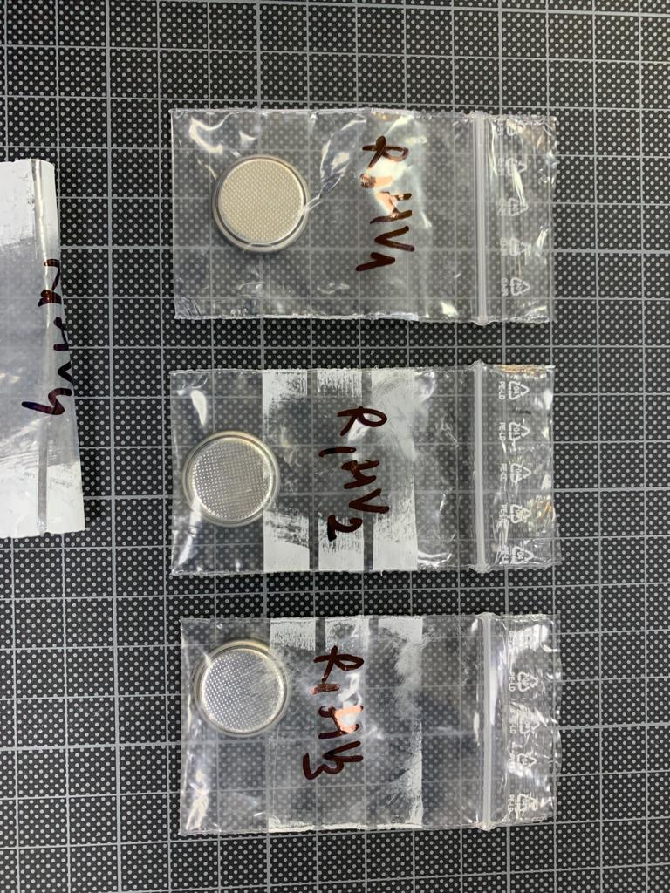
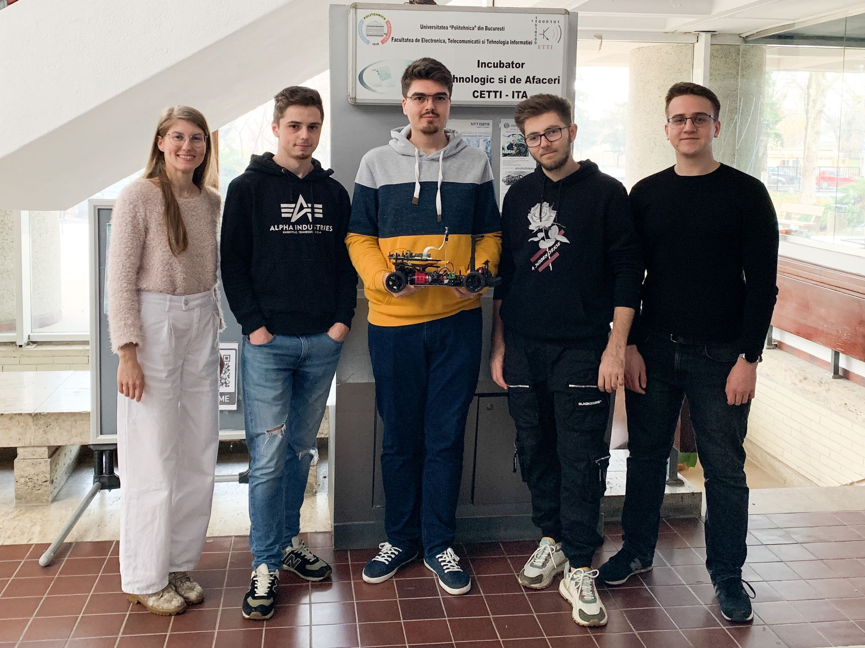
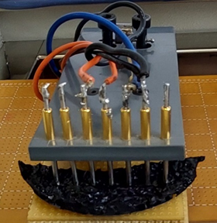
Common Collaborations
Collaboration with The National Research and Development Institute for Cryogenic and Isotopic Technologies – ICSI, Râmnicu Vâlcea with an aim to create supercapacitor cells with high working voltage (over 2.5V
Our chair coordinated the EPS SBC UNST POLITEHNICA of Bucharest team within Bosch Future Mobility Challenge 2023 contest
Presentation at the ISSE 2023 conference of a paper prepared in collaboration with the NTC SBC team Budapest University of Technology and Economics

Slide 10

Future goals
Expand our team
Establishing collaborations
Submit as many projects as possible
We will continue the research about chiplets and supercapacitors

Slide 11
Contact
Rodica NEGROIU - rodica.negroiu@cetti.ro
Mădălina-Irina BURCEA - madalina.burcea@cetti.ro
Anda JÂJÂIE - jajaieanda20@gmail.com
Andreea CHIOREANU - chioreanuandreea370@gmail.com
Daria-Ioana DEDU- daria.dedu@gmail.com
Corina SĂNDULESCU - corina.sandulescu@cetti.ro

Slide 12
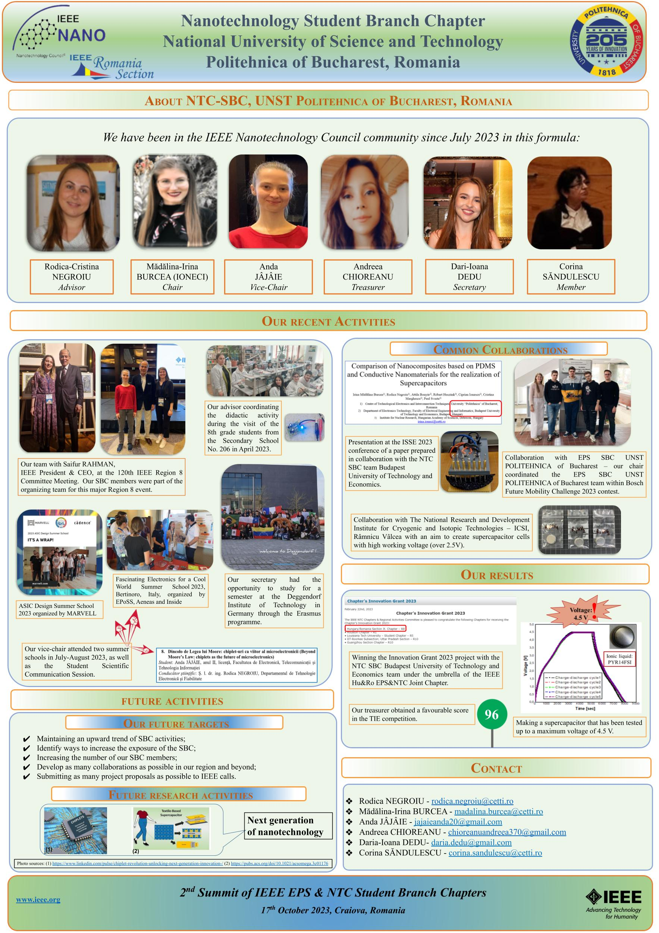
Thank you for your attention and we invite you to view our poster!

